Slide 1

DEPARTMENT OF COMPUTER SCIENCE AND ENGINEERING
MULTI-STRATEGY APPROACH FOR CLICKBAIT DETECTION USING DEEP LEARNING
19NM1A05B8: P.Prameela
19NM1A0579: K.Akshita
19NM1A05B9: P. Jyothika
19NM1A05C4: P. Kesitha
Under the Guidance of
Mr.V.Ramarao
Assistant Professor
14-04-2023
BATCH No: B10
1

Slide 2

Contents
Abstract
Introduction
Existing System and drawbacks
Proposed System and advantages
System Specifications
Algorithms
Designs
Results and Analysis
Conclusion & Future Scope
References
14-04-2023
BATCH No: B10
2
Notes:
14-04-2023
BATCH No:
2

Slide 3
ABSTRACT
Online media outlets, in a bid to expand their reach and subsequently increase revenue through ad monetization, have begun adopting clickbait techniques to lure readers to click on articles.
Our project introduces a unique approach that takes into account all the information present in a Twitter post. Using a bi-directional LSTM, we train our model to determine the degree to which individual words contribute to a post's clickbait score in a distinctive way.
Clickbait is characterized by the use of exaggerated claims in headlines or on social media, which often fail to deliver on their promises. This manipulation of content can mislead. Our project has achieved an impressive accuracy rate of 97% in detecting clickbait, providing a reliable and efficient means of identifying such content.
14-04-2023
BATCH No:B10
3

Slide 4
Introduction
Click-baiting is the intentional act of overpromising or purposely misrepresenting - in a headline, on social media . In some instances, particularly on social media, headlines may lead to web pages that feature a story lacking originality. Instead, the story may contain replicated or altered information from the primary article.
To address this issue, we proposed a clickbait detection project that focuses on Twitter data. By analyzing tweets and their associated metadata, including likes, retweets, and replies, we aim to develop a deep learning model that can accurately detect clickbait content and separate it from genuine, high-quality content.
Our project will utilize a Twitter dataset, which contains a large number of tweets from various sources, including news organizations, celebrities, and ordinary users. We have applied natural language processing techniques and Bi-LSTM networks, to extract features and patterns from the tweets and develop a robust clickbait detection system.
14-04-2023
BATCH No:B10
4

Slide 5
Existing System
The existing system methods focused on word sequence information and also learns the word meanings from entire dataset.
The existing system consists of 3 main sections followed by
(1) Data training and PreProcessing.
(2) Word embedding of the text data into vectors which goes as an input to the CNN
model.
(3) Classification into Clickbait and Non-Clickbait.
14-04-2023
BATCH No:B10
5

Slide 6
Disadvantages of Existing System
The current system for detecting clickbait relies solely on analyzing the phrasing of headlines, which yields an accuracy rate of 0.82%. To improve upon this, the system has been compared to the Random Forest (RF) classification algorithm, but it has been found that this approach does not significantly improve the accuracy of the results.
14-04-2023
BATCH No:B10
6

Slide 7
Proposed System
In our proposed system we are using a multi-strategy approach in this work to address the issue of clickbait detection on the Internet. In clickbait detection, a Bi-LSTM model was trained on a large dataset of Twitter headlines or titles labeled as either clickbait or non-clickbait.
The Bi-LSTM model learns to analyze the sequence of words in a title and predict whether it is likely to be clickbait or not.The output of the Bi-LSTM is a representation of the title that encodes its meaning in a high-dimensional vector.This vector representation can then be fed into a classification layer, such as a softmax layer, to predict whether the title is clickbait or not.
Overall, the Bi-LSTM model is useful for capturing the sequential nature of language and can help to identify linguistic patterns that are indicative of clickbait headlines.
14-04-2023
BATCH No:B10
7

Slide 8
Advantages of Proposed System
Our proposed system uses a multi-strategy approach to solve the problem of clickbait detection.
Capturing contextual information: Bi-LSTM models are effective at capturing the contextual information in natural language text. By processing text in both directions.
Handling variable-length inputs: Clickbait headlines can vary in length, making it difficult to use traditional machine learning models.
Learning from large datasets: Bi-LSTM models are powerful deep learning models that can learn complex patterns from large amounts of data.
14-04-2023
BATCH No:B10
8

Slide 9
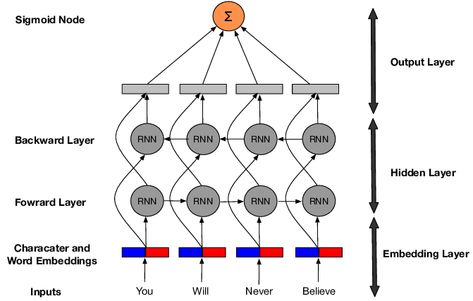
Architecture
Figure : MODEL ARCHITECTURE
14-04-2023
BATCH No:B10
9

Slide 10
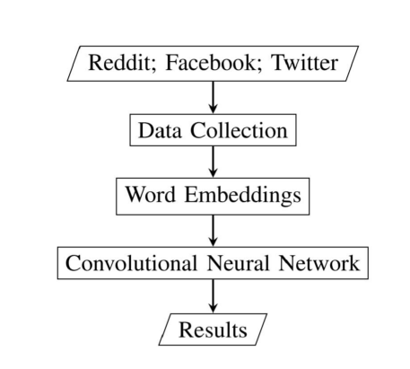
Clickbait Detection Model
Figure: Simple model of clickbait detection
14-04-2023
BATCH No:B10
10

Slide 11
Specifications
Hardware Configuration
Processor - I3/I5 Intel Processor
Hard Disk-160 GB
RAM – 8Gb

Slide 12
Specifications
Software Configuration
Operating System -- Windows 11
IDE – Python Shell / Anaconda
Programming Language – Python
Frontend – Python
Technology – Python 3.6 and flask
14-04-2023
BATCH No:B10
12

Slide 13
Algorithm
BI-LSTM(Bi-Directional long short term memory):
Bidirectional long-short term memory(bi-lstm) is the process of making any neural network have the sequence information in both directions backwards (future to past) or forward(past to future).
In bidirectional, our input flows in two directions, making a bi-lstm different from the regular LSTM.
With the regular LSTM, we can make input flow in one direction, either backwards or forward. However, in bi-directional, we can make the input flow in both directions to preserve the Future and the past information.
In the diagram, we can see the flow of information from backward and forward layers. BI- LSTM is usually employed where the sequence to sequence tasks are needed.

Slide 14
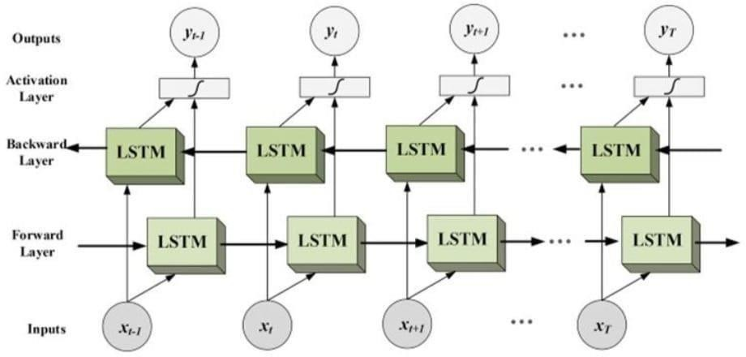
Algorithm
figure : BI-LSTM

Slide 15
Design
Class diagram
A Class diagram in the Unified Modeling Language (UML) is a type of static structure diagram that describes the structure of a system by showing the system's classes, their attributes, operations (or methods), and the relationships among objects.The class diagram is the main building block of object-oriented modeling. It is used for general conceptual modeling of the structure of the application, and for detailed modeling, translating the models into programming code. Class diagrams can also be used for data modeling.

Slide 16
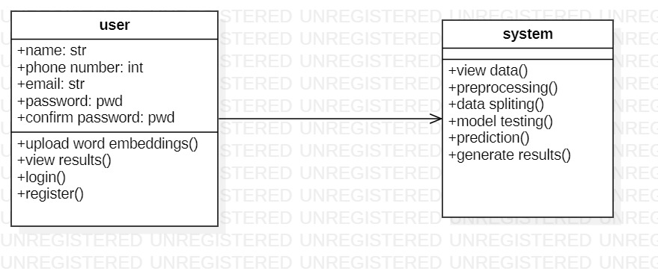
Design

Slide 17
Design
Sequence diagram
A Sequence diagram or system sequence diagram (SSD) shows process interactions arranged in time sequence in the field of software engineering. It depicts the processes involved and the sequence of messages exchanged between the processes needed to carry out the functionality.

Slide 18
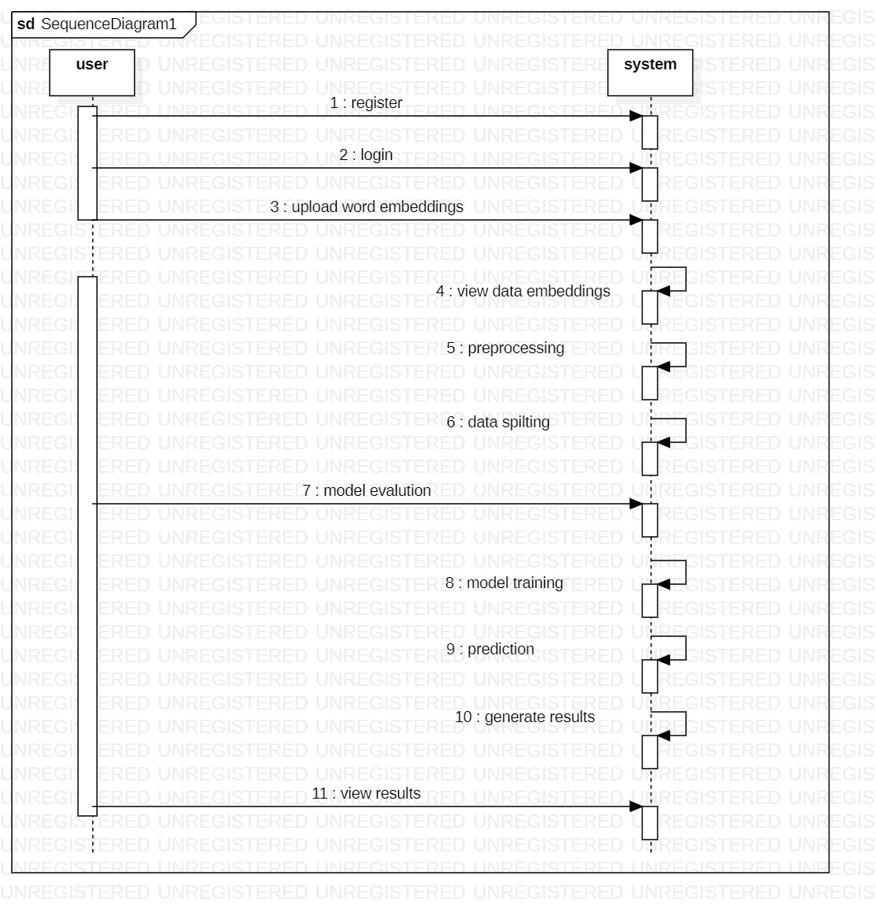
Design

Slide 19
Design
Use Case diagram
A use case diagram is a graphical depiction of a user's possible interactions with a system. A use case diagram shows various use cases and different types of users the system has and will often be accompanied by other types of diagrams as well. The use cases are represented by either circles or ellipses.

Slide 20
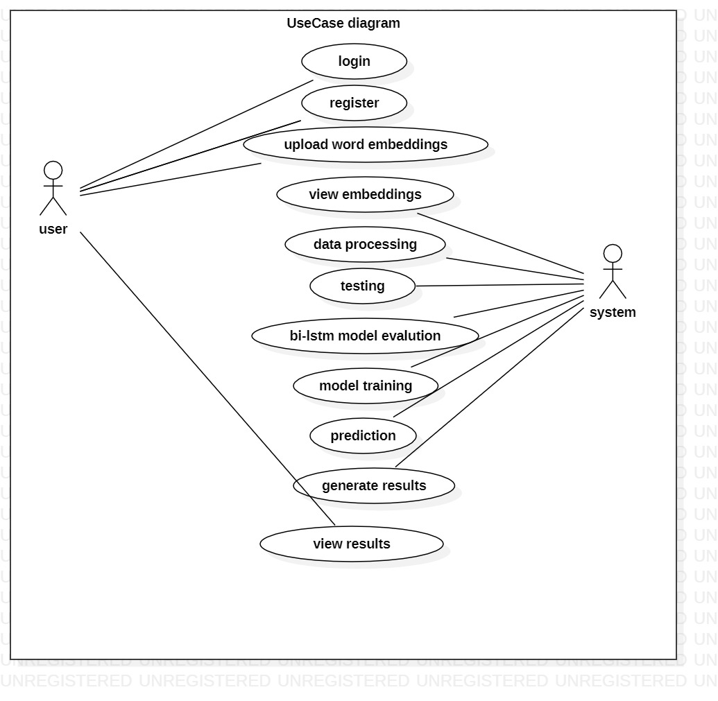
Design

Slide 21
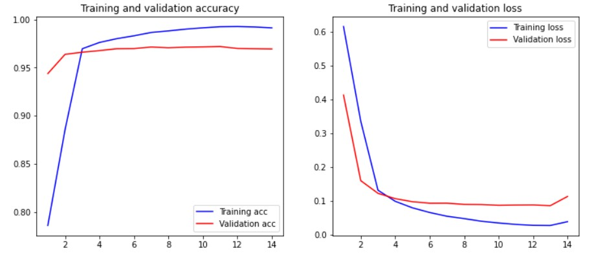
Results and Analysis
Figure: Training and Validation accuracy &Loss

Slide 22
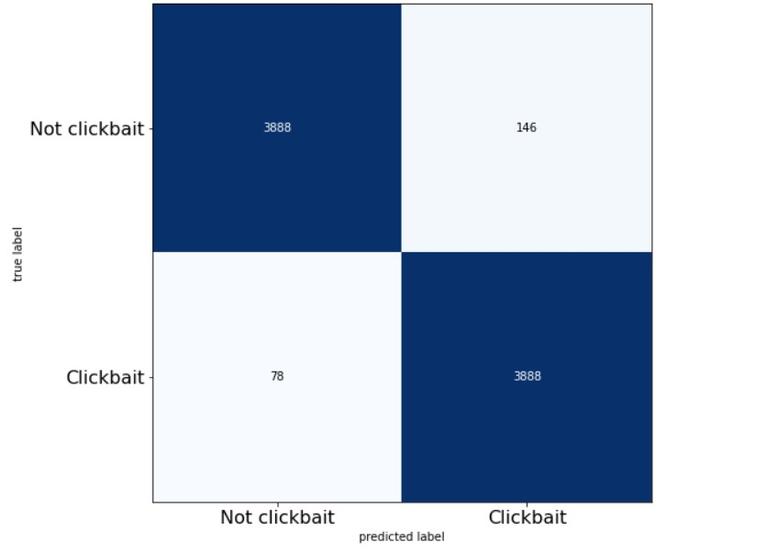
Results and Analysis
Figure: Confusion Matrix

Slide 23
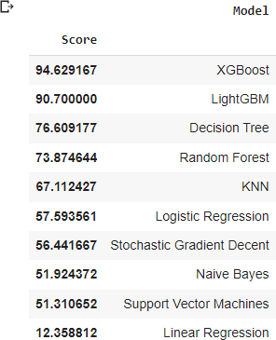
Results and Analysis
Figure 6.1.4 : Accuracy of Clickbait detection using different machine learning algorithms

Slide 24
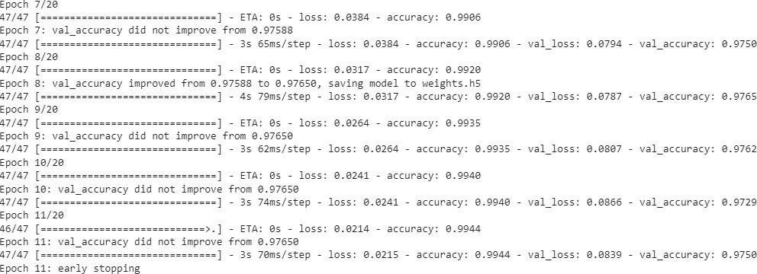
Results and analysis
Figure: Validation Accuracy

Slide 25
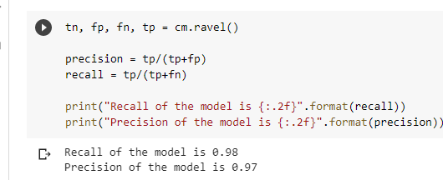
Results and Analysis
Figure : Precision and Recall

Slide 26
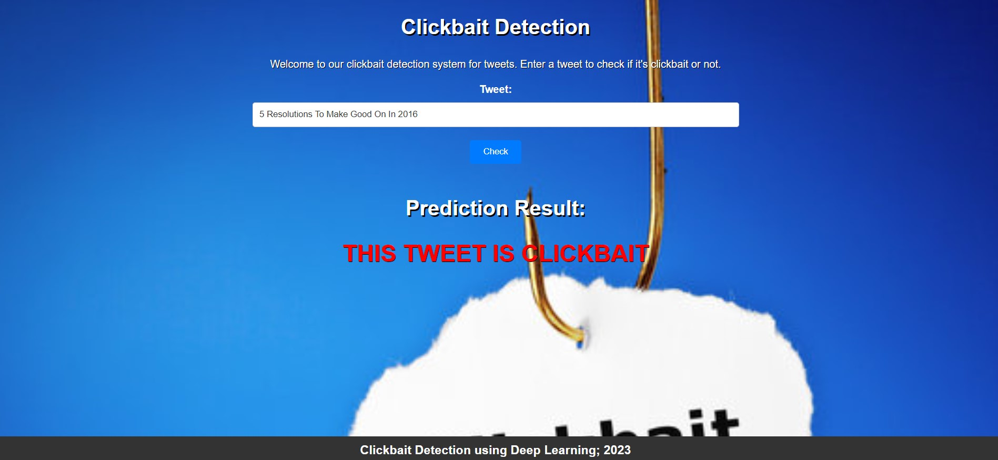
Output Screens

Slide 27
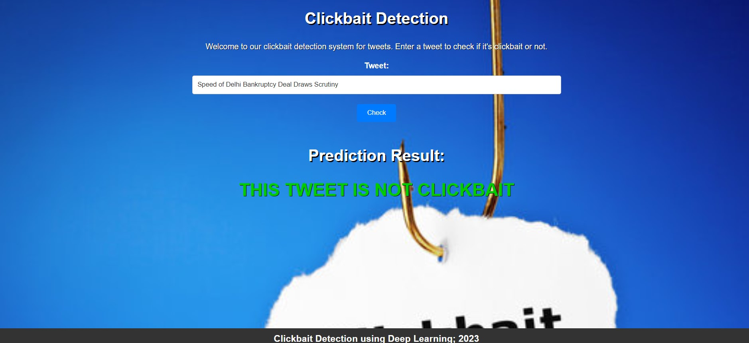
Output Screens

Slide 28
Conclusion
In this project, we explored the use of bi-LSTM neural networks for clickbait detection on Twitter. We trained our model on a dataset of labeled clickbait and non-clickbait tweets, and achieved a high level of accuracy and precision in our predictions.
Our model was able to accurately detect clickbait tweets by analyzing the text content of the tweet and identifying certain patterns and features that are commonly associated with clickbait.
The ability to accurately identify clickbait content can help users make more informed decisions about the information they consume and can also help reduce the spread of fake news and misinformation.
14-04-2023
BATCH No:B10
28

Slide 29
Future Scope
Although our project has achieved high accuracy and precision in detecting clickbait tweets using bi-LSTM, there is still a lot of scope for future improvements and developments in this area. Here are some potential avenues for future research and development:
Currently, our model only analyzes the text content of tweets to detect clickbait. However, there are other features of tweets such as images, videos, and hashtags that can provide additional contextual information that could improve clickbait detection accuracy. Future research could explore incorporating these features into the bi-LSTM model to improve its performance.
14-04-2023
BATCH No:B10
29

Slide 30
References
[1]Ankesh Anand, Tanmoy Chakraborty, and Noseong Park. 2017. We used Neural Networks to Detect Click-baits: You won’t believe what happened Next!. In Advances in Information Retrieval. 39th European Conference on IR Research (ECIR 17) (Lecture Notes in Computer Science). Springer.
[2]Dzmitry Bahdanau, Kyunghyun and Yoshua Bengio. 2014. Neural machine translation by jointly learning to align and translate. arXiv preprint arXiv:1409.0473 (2014).
[3]Prakhar Biyani, Kostas Tsioutsiouliklis, and John Blackmer. 2016. "8 Amazing Secrets for Getting More Clicks": Detecting Clickbaits in News Streams Using Article Informality. In Proceedings of the Thirtieth AAAI Conference on Artificial Intelligence (AAAI’16). AAAI Press, 94–100. http://dl.acm.org/citation.cfm?id= 3015812.3015827
14-04-2023
BATCH No:B10
30

Slide 31
THANK YOU
Queries?
14-04-2023
BATCH No:B10
31

